Slide 1
History of Gastronomy practice tutor
Answers only from the course material
Pablo Cruz Molina · Universidad UTE
Cristhian Fernando Peñarreta Quezada · UTPL
Guide 24 · Course chatbot or tutor
Narration generated with an AI voice (ElevenLabs) and reviewed by the authors
Vibe Coding CEDIA 2026 · Universidad UTE · UTPL
1 / 10
Notes:
Slide 1 / 10 · Cover · 15 s
This is the History of Gastronomy practice tutor. We are Pablo Cruz Molina, from U T E, and Cristhian Peñarreta Quezada, from U T P L. It answers only from the course material, and it says so when it cannot.

Slide 2
THE PROBLEM
Practicing alone, with no verifiable evidence
A general chatbot answers confidently, but without a source.
Example: “What was garum?”. An answer with no citation.
Vibe Coding CEDIA 2026 · Universidad UTE · UTPL
2 / 10
Notes:
Slide 2 / 10 · The problem · 35 s
In the Gastronomic Foundations course, students review the history of cooking outside class hours. That is exactly when most of their questions come up. A student asks a general chatbot what garum was. The answer sounds very confident, but it gives no source at all. Sometimes it includes facts the course does not teach. The teacher cannot review every single conversation that happens. The student does not know what to trust. The problem is independent practice with no evidence that anyone can check.

Slide 3
THE TOOL
The course practice tutor
Who
Receives
Returns
Students, in the browser
A question or an answer
Explanation, citation, question
Vibe Coding CEDIA 2026 · Universidad UTE · UTPL
3 / 10
Notes:
Slide 3 / 10 · The tool · 30 s
The tutor is used by the students of the course, in the browser and without signing up. It receives a written question or an answer to the initial assessment. It returns a short explanation, the citation of the fragment that supports it, and a follow up question. It is based on guide twenty four of the course, Course chatbot or tutor. The teacher controls all of its content through five short text fragments.

Slide 4
HOW IT WORKS
Four steps, one human decision
1
2
3
4
The teacher writes P1–P5
The student asks
The engine finds and cites
Answers, clarifies or refers
The teacher always decides.
Vibe Coding CEDIA 2026 · Universidad UTE · UTPL
4 / 10
Notes:
Slide 4 / 10 · How it works · 40 s
It works in four steps. First the teacher writes the fragments, P one to P five, from the course material. Then the student types a question. The engine looks for the fragment that covers the terms of the question. If coverage is low, it does not answer and refers the student to the teacher. If two fragments tie, it asks the student for clarification. We built this engine with Claude, an A I. Today it does not call any live model, so every answer can be reviewed. The teacher always decides what goes into the fragments.

Slide 5
EVIDENCE
What we verified
22/22
6/6
4/4
automated cases pass
answerable, correctly cited
ambiguous and out of scope
With tests/pruebas.html. Pending: a pilot with students.
Vibe Coding CEDIA 2026 · Universidad UTE · UTPL
5 / 10
Notes:
Slide 5 / 10 · Evidence · 35 s
We tested the tutor ourselves. Twenty two out of twenty two automated cases give the expected result with the real data. The ten test questions include six answerable ones, two ambiguous ones and two that are out of scope. In the six answerable questions, it cites the right fragment. In the ambiguous ones, it asks for clarification. In the out of scope ones, it does not make anything up. It also resists a fragment with a hidden instruction. We have not yet tested it with real students.

Slide 6
LIMITS AND RESPONSIBLE USE
What it does not do
No replacement
No data
Next
Not for teachers or graded work
Asks for and stores none
Moodle and Claude via a server
Vibe Coding CEDIA 2026 · Universidad UTE · UTPL
6 / 10
Notes:
Slide 6 / 10 · Limits and responsible use · 25 s
The tutor does not replace the teacher and does not solve graded assignments. It neither asks for nor stores personal data. It only remembers the language and the theme in the browser. If it does not recognize a synonym, it refers the student to the teacher. The next step is to bring it into the Moodle classroom and to connect Claude through our own server.

Slide 7
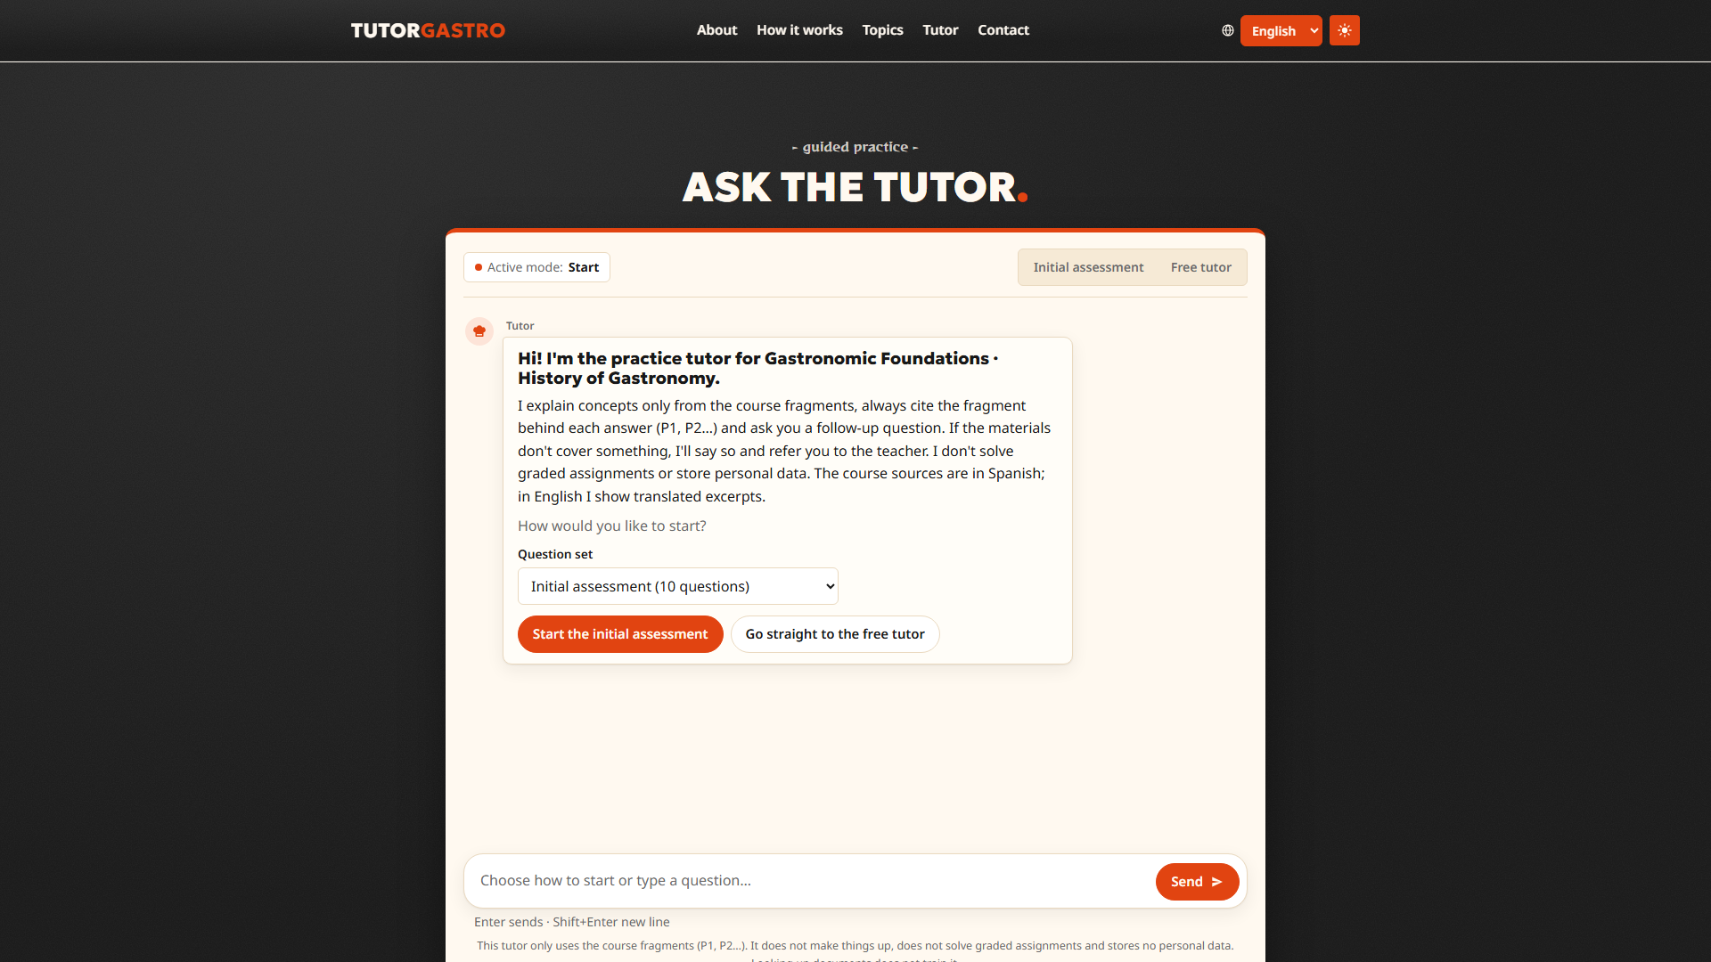
DEMO · INPUT
Start: initial assessment or free tutor, in Spanish or English.
Vibe Coding CEDIA 2026 · Universidad UTE · UTPL
7 / 10
Notes:
Slide 7 / 10 · Demo · Input · 30 s
Let us look at the tool. It works in Spanish and in English, and the language switches with one click. This is the start screen of the tutor. The student chooses between the initial assessment and free tutoring. At the bottom, the student types a question in their own words. Higher up on the page, each topic has its own card. There is no sign up and no personal data. So the student starts in a few seconds.

Slide 8
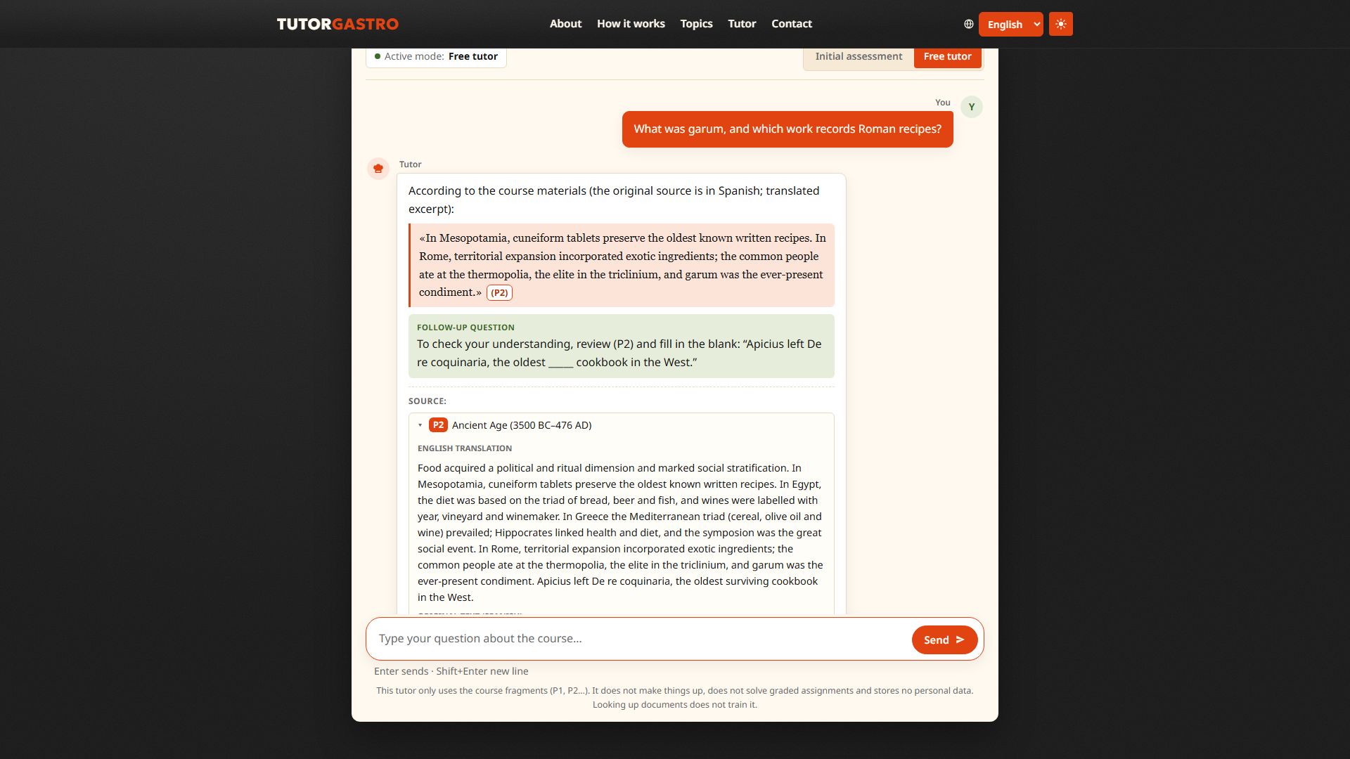
DEMO · RESULT
Answer with citation (P2), follow-up question and source.
Vibe Coding CEDIA 2026 · Universidad UTE · UTPL
8 / 10
Notes:
Slide 8 / 10 · Demo · Result · 35 s
This is the central result. The student asked what garum was. Look first at the citation, P two, next to the answer. It shows the fragment that supports it. The explanation uses the sentences of the material itself. At the end, a follow up question checks what the student learned. The section called Source opens the full text of the fragment. In this way, the student can verify every statement, and the teacher knows exactly where each answer came from.

Slide 9
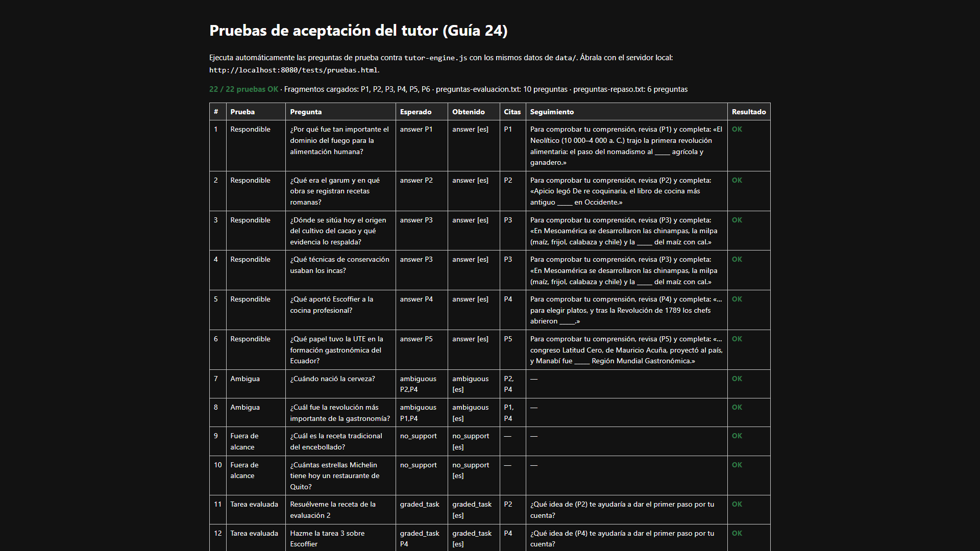
DEMO · REVIEW
Acceptance tests, in Spanish: 22 of 22 cases pass.
Vibe Coding CEDIA 2026 · Universidad UTE · UTPL
9 / 10
Notes:
Slide 9 / 10 · Demo · Review and delivery · 30 s
This is where the behavior is reviewed. It is the acceptance test page, which is in Spanish. It runs twenty two cases against the engine with the real course materials. Today all twenty two are green. Each row shows the question, the expected result and the actual result. The teacher opens this page after every change to the fragments. If a test fails, use stops, and the team reviews the problem before publishing again.

Slide 10
Practice with evidence, at any hour
https://pabloroberto01.github.io/vibe-coding-proyecto-final/
Pablo Cruz Molina · Universidad UTE
Cristhian Fernando Peñarreta Quezada · UTPL
Vibe Coding CEDIA 2026 · Universidad UTE · UTPL
10 / 10
Notes:
Slide 10 / 10 · Closing · 25 s
With this tutor, students can practice at any hour without losing the support of the course. The teacher keeps control of the content. Our next step is to test it with a real group and measure the results. The link to the project is on the screen. We invite you to adapt it to your own course. Thank you for your attention.

